Slide 1
CREDIT CARD APPROVAL PREDICTION
Presented by: Souvik Chowdhury

Slide 2
Few Statistics
438510 customers record present
45985 customers have taken a credit card
No of Customers do not have any credit card : 402100
No of Customers have credit card but customer related records are missing : 270860
No of customers with records available and has taken credit card: 36457
Average Income : 187520

Slide 3
PROBLEM
Need to identify customers who might default and based on that approval process will take place.
The data is highly imbalanced since only some small portion of customers will default the credit card payment.

Slide 4
APPROACH
Weight of Evidence and Information value
I calculated the information value and weight of evidence for each features
Machine Learning Approach
I have used 6 Machine Learning models to test the performance. I have also used feature engineering methods to generate new features.
Based on them found some of the newly generated features are working better in terms of information value and weight of evidence.
Since the data is highly imbalanced I have used SMOTE (Synthetic Minority Oversampling Technique) to resample the dataset.

Slide 5
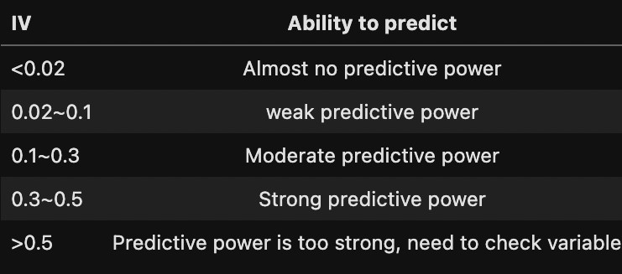
WEIGHT OF EVIDENCE AND INFORMATION VALUE
WoE & IV
IV is based on an analysis of each independent variable without considering other predictor variables. WOE - Closely related to the IV value, WOE measures each grouped attribute's strength in predicting the Dependent Variable's desired value.
This table shows the value and the predictive power

Slide 6
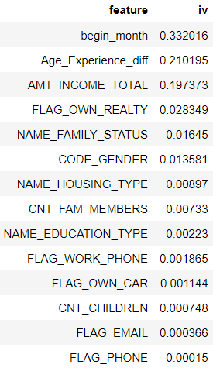
WEIGHT OF EVIDENCE AND INFORMATION VALUE (In the experiment)
From the image, we can find begin_month and Age_Experiment_diff has quite a significant information value
Both are new features generated begin_month when customer has 1st credit card opened.
Age_experiment_diff is difference between customer age and experience

Slide 7
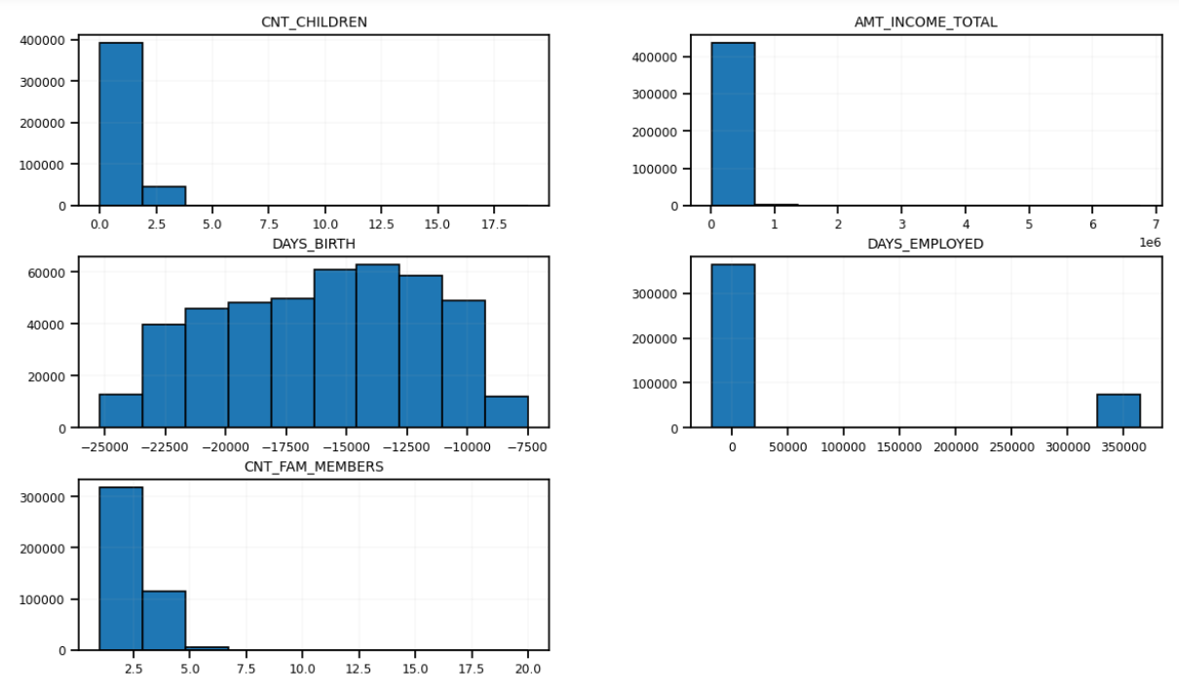
CNT_CHILDREN, AMT_INCOME_TOTAL, CNT_FAM_MEMBERS has outliers
The last bar in DAYS_EMPLOYED graph represents the customer is currently unemployed. (From the definition of dataset)
Bar Plot

Slide 8
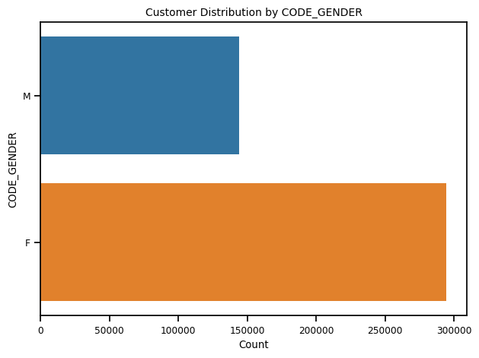
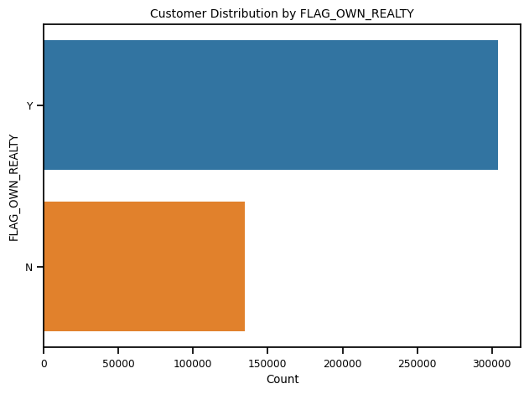
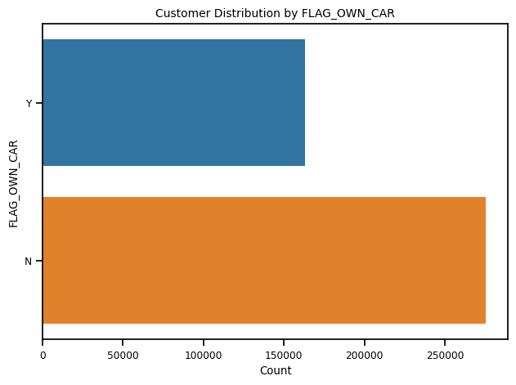
Bar Plot
Majority of customer are female and own a property but don’t have a car.
I can infer from this majority of customers are sensible towards building wealth rather than going for luxury products like car. (though now a days car is almost essential). But I feel majority of customers prefer public transport.

Slide 9
Bar Plot
Majority of customer are female and own a property but don’t have a car.
I can infer from this majority of customers are sensible towards building wealth rather than going for luxury products like car. (though now a days car is almost essential). But I feel majority of customers prefer public transport.

Slide 10
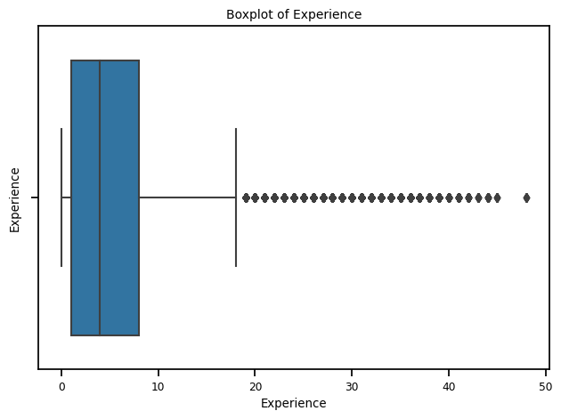
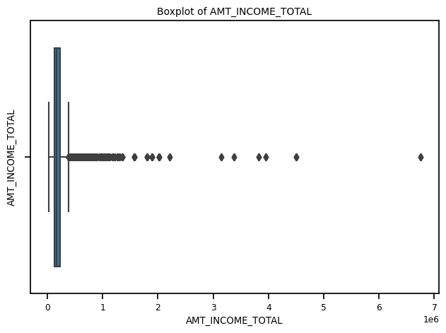
Box Plot
Experience and AMT_INCOME_TOTAL has outliers
People with experience close to 50 is something very strange.
This gives me the intuition to deduce a new feature Age_Experience_Diff.

Slide 11
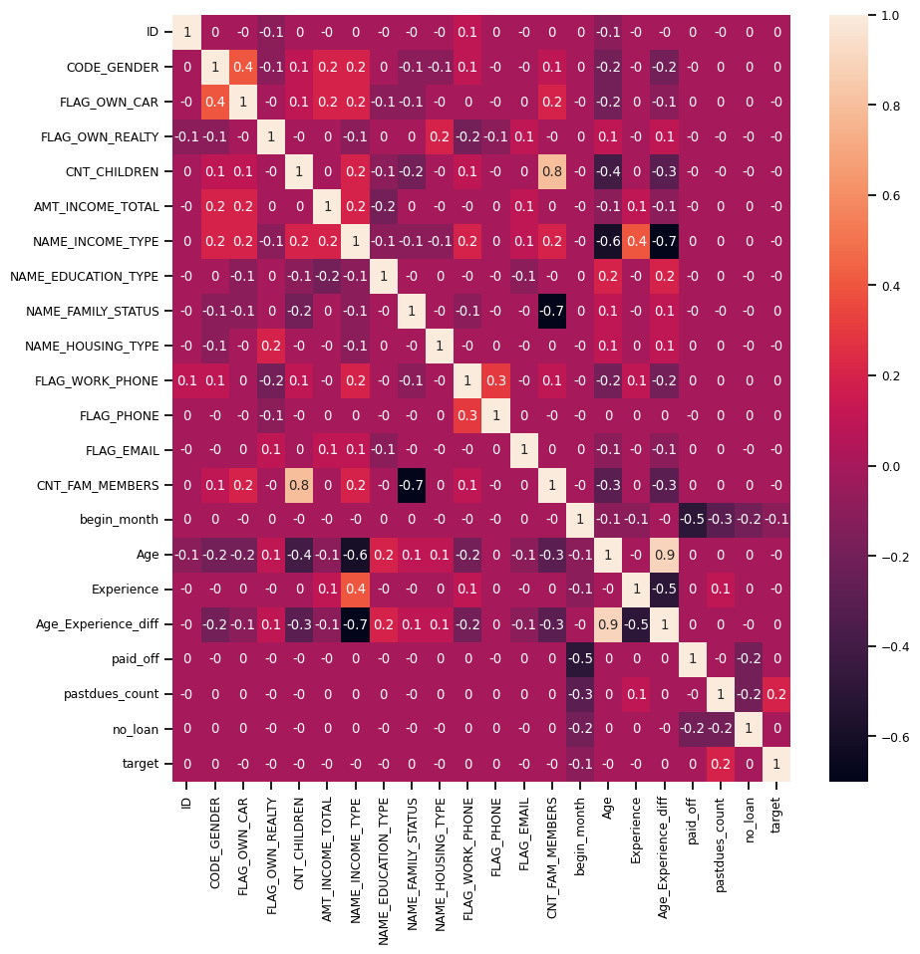
Correlation Heatmap:
NAME_INCOME_TYPE has a strong correlation with Age_Experience_diff.
I will drop NAME_INCOME_TYPE because it has quite a less information value.

Slide 12
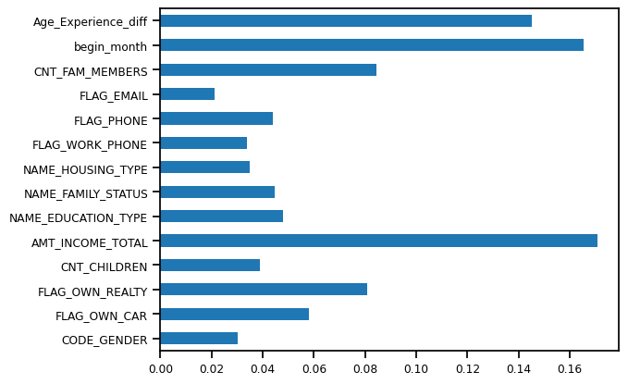
Feature Importance :

Slide 13
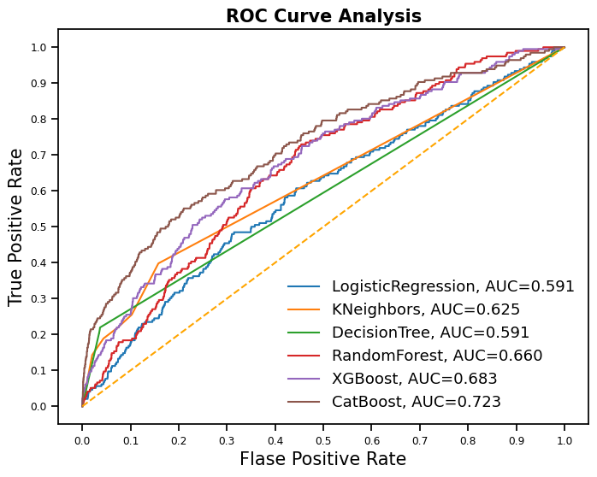
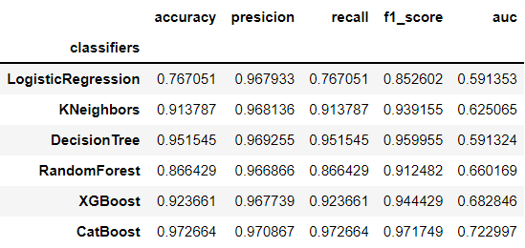
ROC AUC Curve
From ROC AUC curve we can see CatBoost is covering 72% area.
Below is performance statistics.
Since the data is imbalanced accuracy will give misleading results. We should follow roc-auc,precision,recall,f1-socore which make more sense.

Slide 14
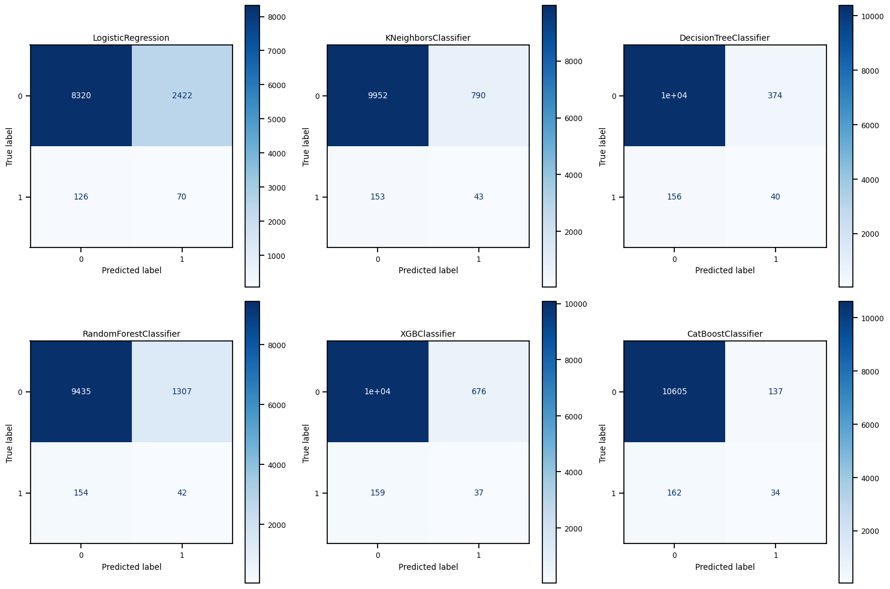
Confusion Matrix

